Slide 1
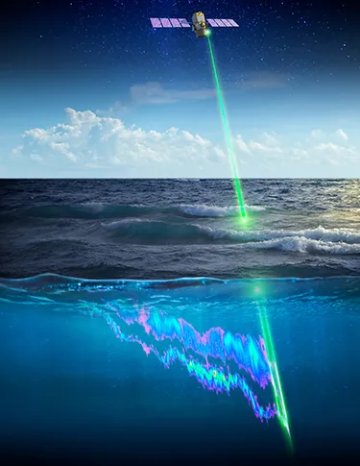

Problem statement
Prediction of sea surface currents by using Deep neural network and satellite observations of sea surface winds, height and temperatures in the North Indian Ocean.
Mentor : Jaikumar Pundir

Slide 2
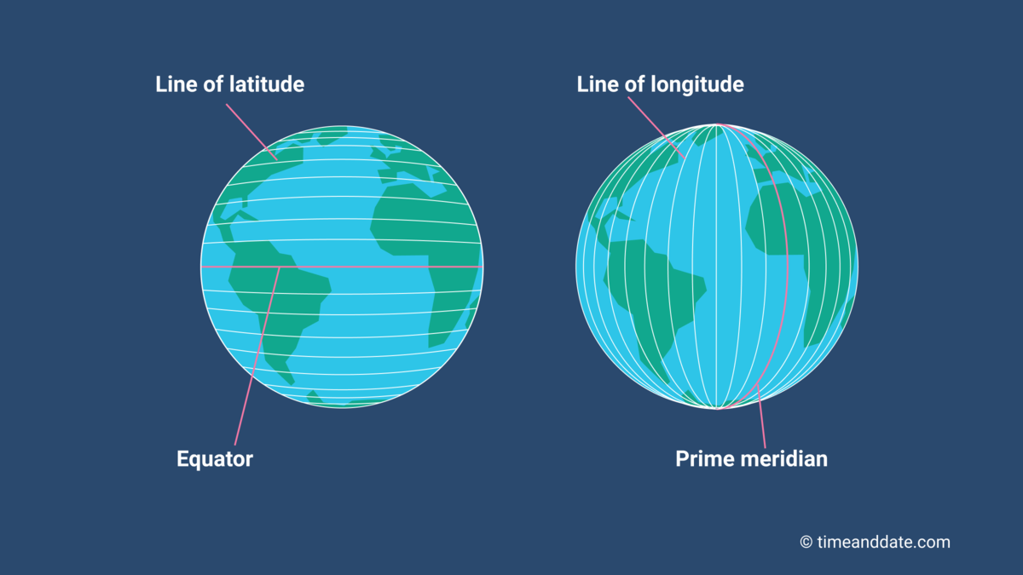
Basics about data
We have 4 columns in our data Time, Longitude, Latitude, ADT
Which are important parameters for our data
Latitude: Lines that run east-west, showing how far north or south a place is from the equator.
Longitude: Lines that run north-south, showing how far east or west a place is from the Prime Meridia
Together, they create a grid to pinpoint any location on Earth.
Time: Time changes when you cross time zones, but your longitude and latitude remain the same, keeping your exact location on Earth unchanged.

Slide 3
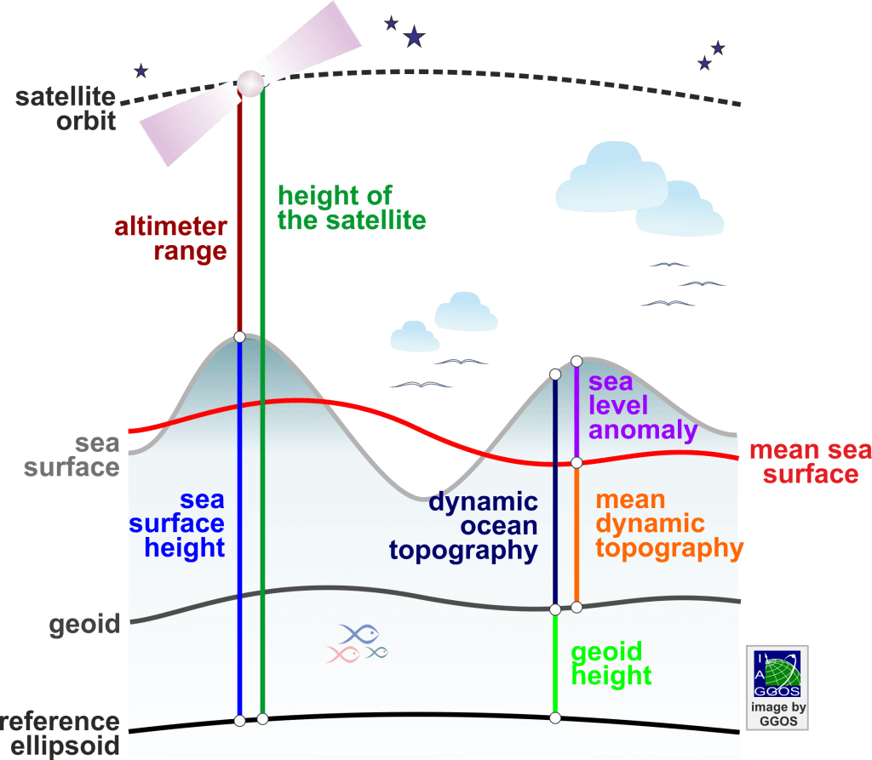
ADT (Absolute Dynamic Topography)
It measures the height of the sea surface compared to a reference level (geoid), showing ocean currents.
Higher ADT means warmer, less dense water
lower ADT means cooler, denser water.
The absolute dynamic topography is the sea surface height above geoid the adt is obtained as adt = sla + mdt
Absolute
SSH: Sea Surface Height
SLA: Sea Level Anomaly
MSS : Mean Sea Surface
MDT : Mean Dynamic Topography

Slide 4
Why .nc files?
A .nc file is a NetCDF file, which is a format for storing scientific data. NetCDF stands for Network Common Data Form.
We have a datafile in .nc format so let’s see what do we know about .nc files.
.nc files can store a variety of scientific data in a structured and efficient way.
Multidimensional data (e.g., time, depth, latitude, longitude).
Variables (e.g., temperature, wind speed).
Metadata (e.g., units, descriptions).
Gridded data (e.g., maps, satellite images).
Large datasets efficiently.
Perfect for climate, weather, and ocean data

